Slide 1
Spring Security 7
Intergrating JWT

Slide 2
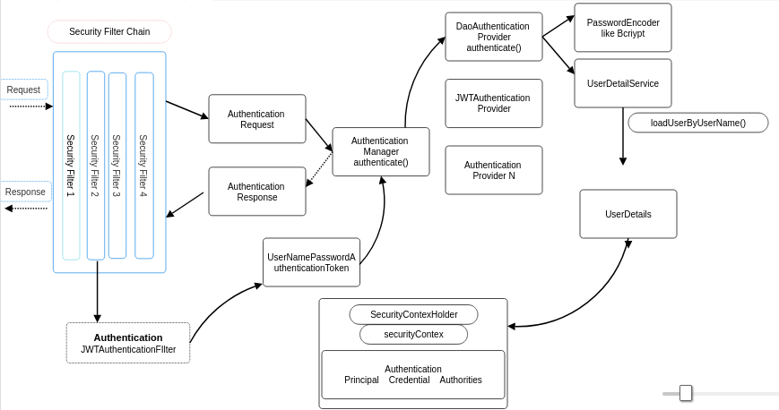
Deep Dive

Slide 3
What is JWT?
JSON web token(JWT)
Securely transfer information over the web(between two parties).
Used for an authentication system and information exchange.
The token is mainly composed of header, payload, signature.
These three parts are separated by dots(.).
JWT defines the structure of information we are sending from one party to the another.

Slide 4
JWT Structure
A JWT represents a string in the following format
[header].[payload].[signature]
Header
Describes the cryptographic operations applied to the JWT like signing/decryption technique used on it.
Can also contain the data about the media/content type of the information we are sending.
This information is present as a JSON object then this JSON object is encoded to BASE64URL.
A simple header of a JWT looks like the code below:
{
"typ":"JWT",
"alg":"HS256"
}

Slide 5
JWT Structure
Payload
All the user data is actually added.
This data is also referred to as the ‘claims’ of the JWT.
Information is readable by anyone so do not put any confidential information in here.
This part generally contains user information.
This information is present as a JSON object then this JSON object is encoded to BASE64URL.
We can put as many claims as we want inside a payload,
The JWT with the payload will look something like this:
{
"userId":"b07f85be-45da",
"iss": "https://provider.domain.com/",
"sub": "auth/some-hash-here",
"exp": 153452683
}

Slide 6
JWT Structure
Signature
This is the third part of JWT
Used to verify the authenticity of token.
BASE64URL encoded header and payload are joined together with dot(.)
And it is then hashed using the hashing algorithm defined in a header with a secret key.
This signature is then appended to header and payload using dot(.) which forms our actual token header.payload.signature
Syntax
HASHINGALGO( base64UrlEncode(header)+“.”+base64UrlEncode(payload),secret)

Slide 7
How does a signature ensure authenticity?
A signature can only be created by someone possessing a secret key, and the original payload.
Signatures are generally formed by combining the data to be signed with a secret key
By appending them together and hashing them (HS256), or
By encrypting a representation of that data (a hash) using the secret key (RS256).
HS256
Symmetric signing method
Secret key is shared between the sender and the receiver
RS256
Asymmetric signing method
Sender uses the private key and recipient uses the public key

Slide 8
JWT Structure
To know the structure refer
www.jwt.io

Slide 9
Introducing JWT
Steps
Add Maven Dependencies
Create JwtService
Create JwtAuthenticationFilter
Entry in SecurityConfig
.addFilterBefore(jwtAuthFilter, UsernamePasswordAuthenticationFilter.class);
Entry in MyUserController
After successful authentication, generate the jwt token and return it as response.
final String jwt = jwtService.generateToken(user);

Slide 10
Steps with code
Refer 5. Spring_security_7_jwt_guide_with_code.txt

Slide 11
Questions?

